Slide 1

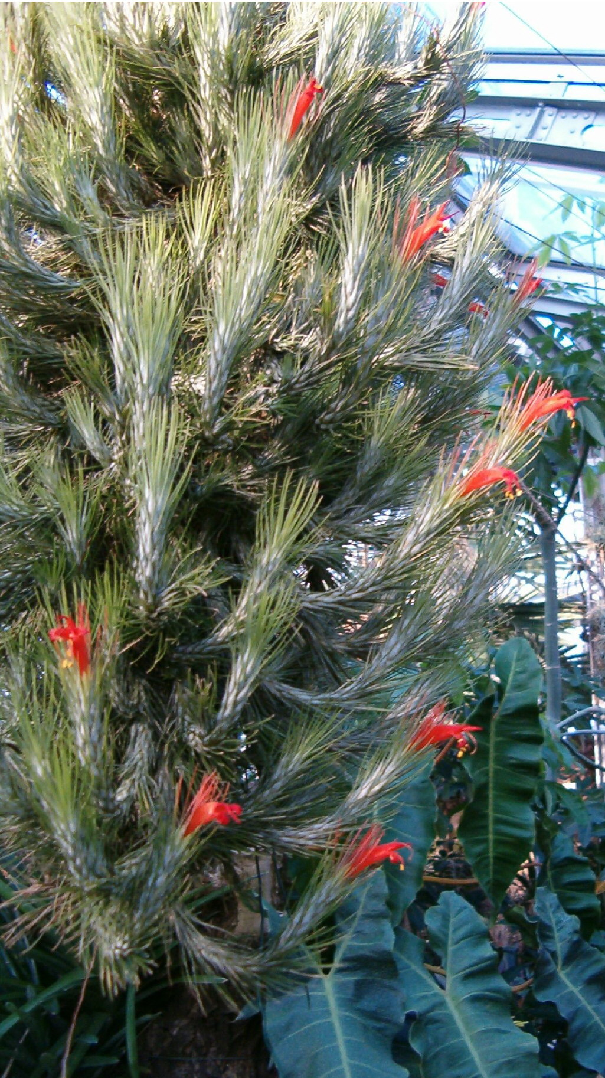
Gil Yardeni, Michael H. J. Barfuss, Walter Till, Matthew R. Thornton, Clara Groot Crego, Christian Lexer, Thibault Leroy and Ovidiu Paun. 2025. “The Explosive Radiation of the Neotropical Tillandsia Subgenus Tillandsia (Bromeliaceae) Has Been Accompanied by Pervasive Hybridization” Systematic Biology doi.org/10.1093/sysbio/syaf039
Class focus area: Networks
EEB603: Brian O’Meara
M. Nabil
BotBln
All quotes and images from the above paper unless otherwise noted

Slide 2
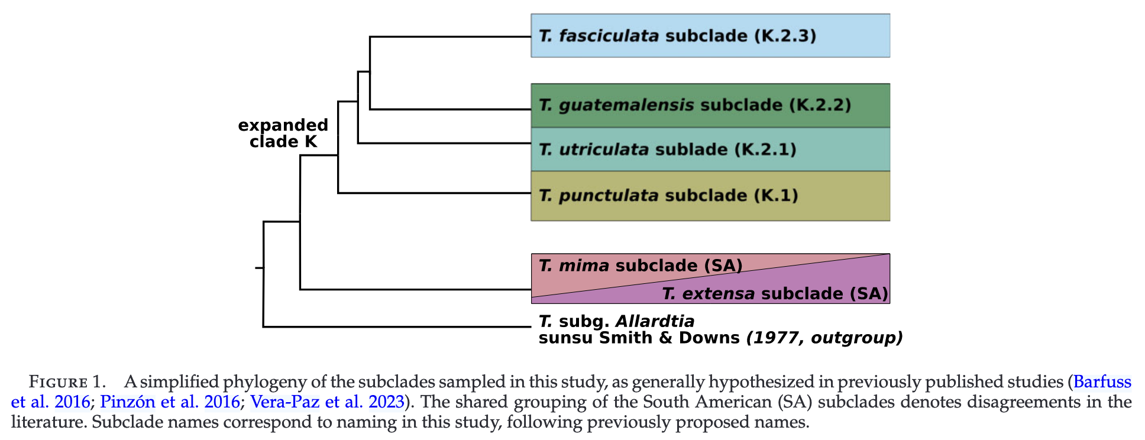
“I heard you liked Tillandsia, so I put subgenus Tillandsia inside genus Tillandsia”

Slide 3
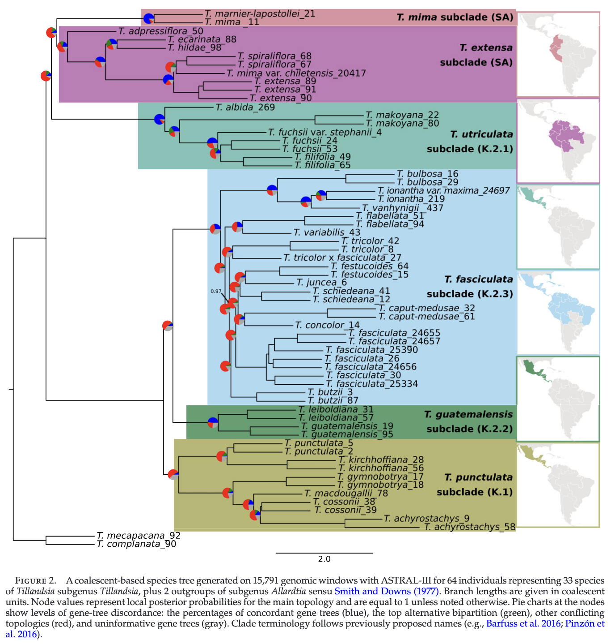

Slide 4
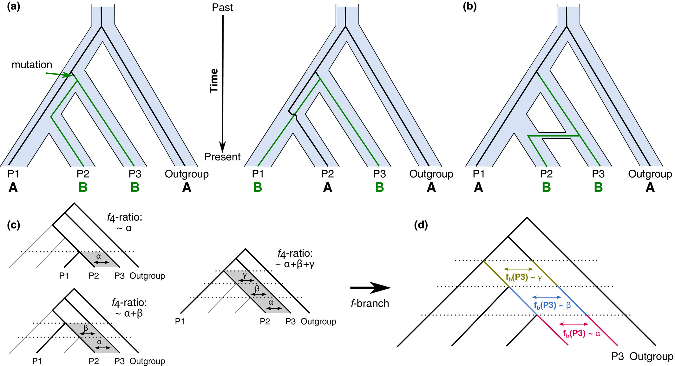
Basic principles behind the D and f-branch statistics. (a) Example genealogies showing the sharing of derived alleles, denoted as 'B' between populations P2 and P3 (the ABBA pattern) and between P1 and P3 (the BABA pattern) as a result of incomplete lineage sorting. In a scenario without gene flow, both patterns are assumed to be equally likely (but see (Eriksson & Manica, 2012 for exceptions). (b) Gene flow between P2 and P3 introduces additional loci with ABBA patterns, which would lead to a positive D statistic. (c) An example illustrating interdependences between different f₄-ratio scores, which can be informative about the timing of introgression. In this example, different choices for the P1 population provide constraints on when the gene flow could have happened. (d) Based on relationships between the f₄-ratio results from different four taxon tests, the f-branch, or f_{b} statistic, distinguishes between admixture at different time periods, assigning signals to different (possibly internal) branches in the population/species tree. Malinski et al. 2021

Slide 5
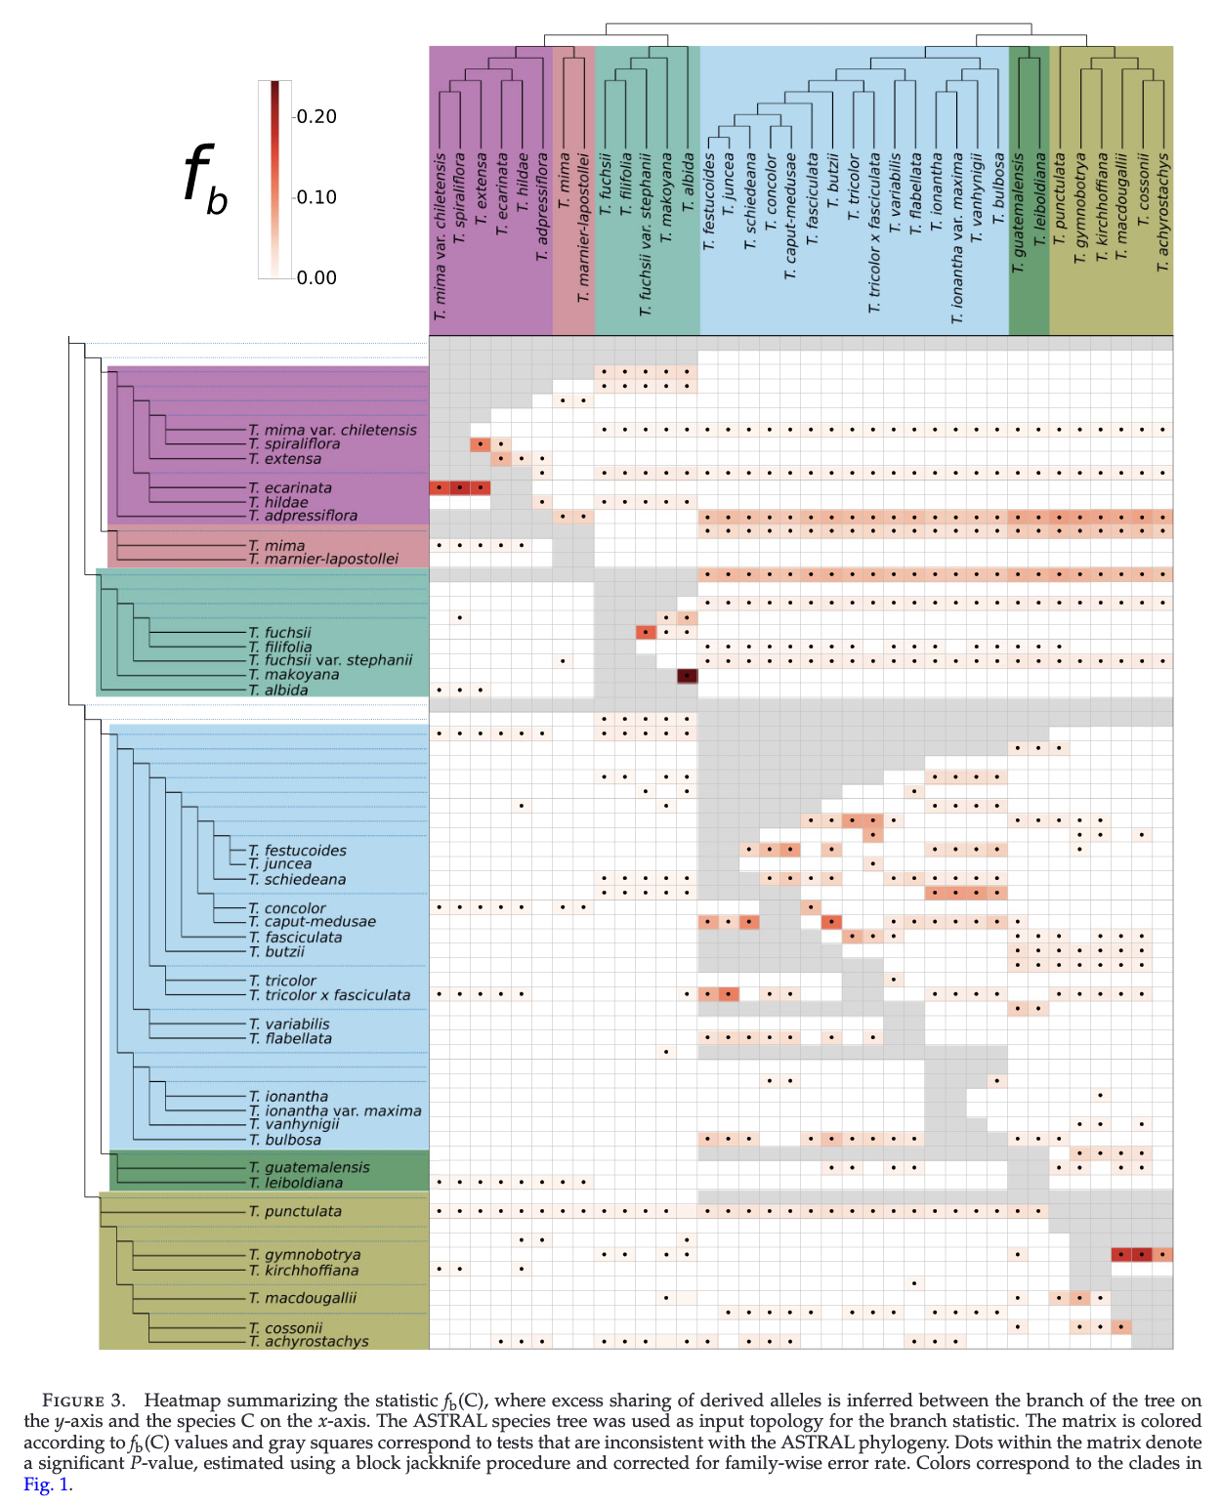

Slide 6
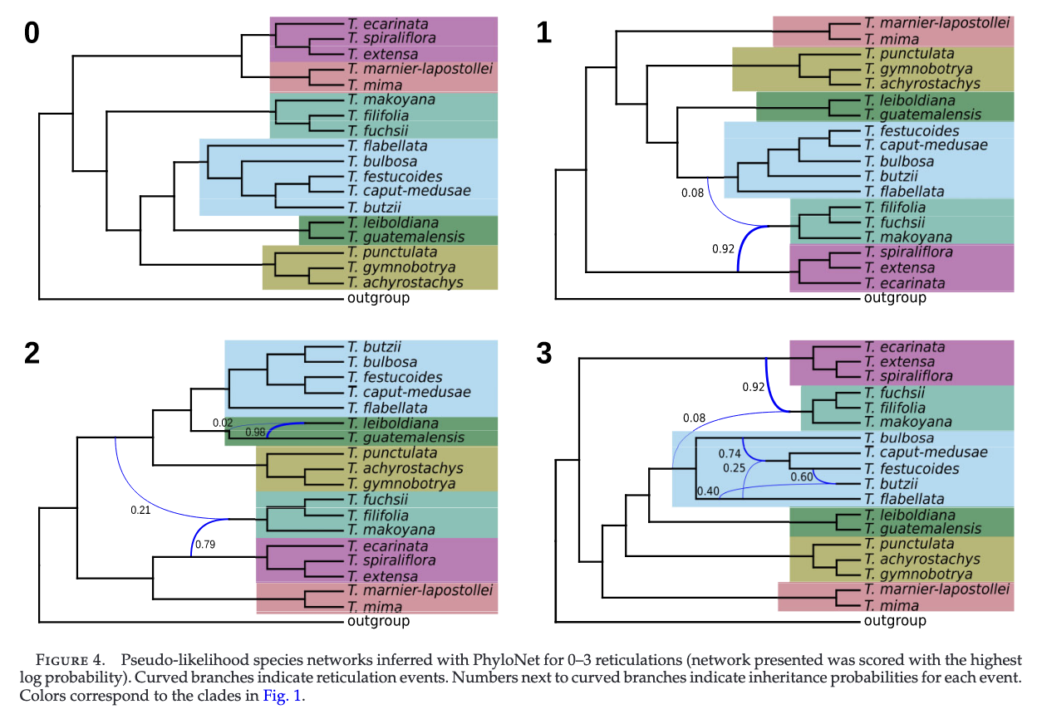

Slide 7
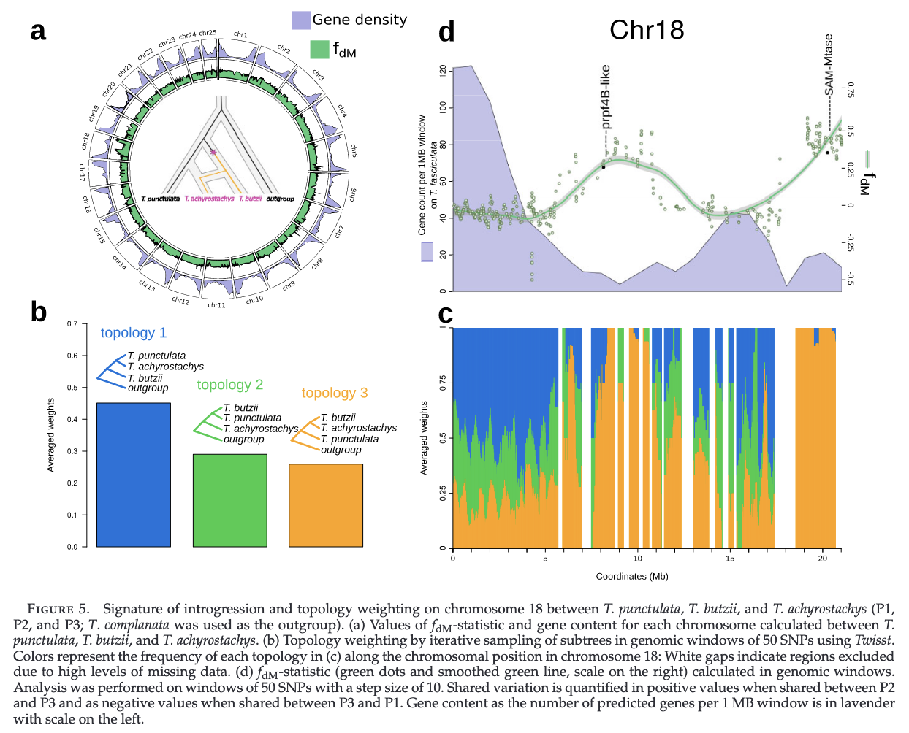

Slide 8


What is a window?
What is introgression?
What is reticulation?
ABBA-BABA
ILS vs reticulation?

